Slide 1
Introduction To Google Earth Engine

Slide 2
Objectives
Setup a Google Earth Engine account, gain familiarity with the Google Earth Engine (GEE) Code Editor using JavaScript and use the platform to build a geospatial application. The skills gained (hopefully!) can very quickly be expanded for more advanced geospatial work.
1. Day 1 :
Setup a Google Earth Engine account, gain familiarity with the Code editor and JavaScript for GEE.
Familiarize with the GEE Objects, Methods and Datasets.2.
Day 2 :
- Use the skills from Day 1 to build a geospatial application.

Slide 3
What is GEE and what makes is it so interesting ?
Google Earth Engine is "a geospatial processing service" by Google. The [Google Earth Engine](https://developers.google.com/earth-engine) website lists the following purposes of the Earth Engine :
- Provide an interactive platform for geospatial algorithm development at scale
- Enable high-impact, data-driven science
- Make substantive progress on global challenges that involve large geospatial datasets

Slide 4
In simple terms, Google Earth Engine is a cloud service which offers access to large scale geospatial datasets resource, provides a platform for manipulation of Geospatial data.
Manipulation of geospatial data requires huge computational workflow, and a specialized skill set to deal with the data. Downloading these large datasets and its processing takes a lot of valuable time and physical resources. Google Earth Engine provides a single platform and a highly simplified workflow to deal with these datasets. A basic computer and an acceptable internet connection is all which is required to manipulate large datasets, making "science" more accessible to all. A [study](https://www.mdpi.com/2072-4292/10/10/1509) on the Usage, Trends, and Potential of GEE reports that showed "that a total of 300 journal papers were published between 2011 and June 2017 that used GEE in their research, spread across 158 journals."

Slide 5
What resources are available to enter the world of GEE ?
There are several sources of information and tutorials available to get into GEE. Some sources include :
Google Earth Engine Website, has tons of resources. We will be basing this introductory tutorial mostly on the tutorials on this website.
Google Earth Engine web console has lots of examples on the web console it self.
Google Earth Engine Applications (which uses the online console), are written in JavaScript, so we can normally visually inspect the code from GEE applications using the browser.
Stack Exchange / Youtube for anything and everything.

Slide 6
How to Setup :
Required :
A computer with an internet connection. (Any decent computer should work fine!)
To Setup:
Register to use Earth Engine.
Go to the Google Earth Engine Sign Up page.
We can use personal emails or organizational (college) email, depending on preference. In some cases personal emails might not get accepted, so college email might be used. Or one might prefer to make a personal Google Account just to use GEE.

Slide 7
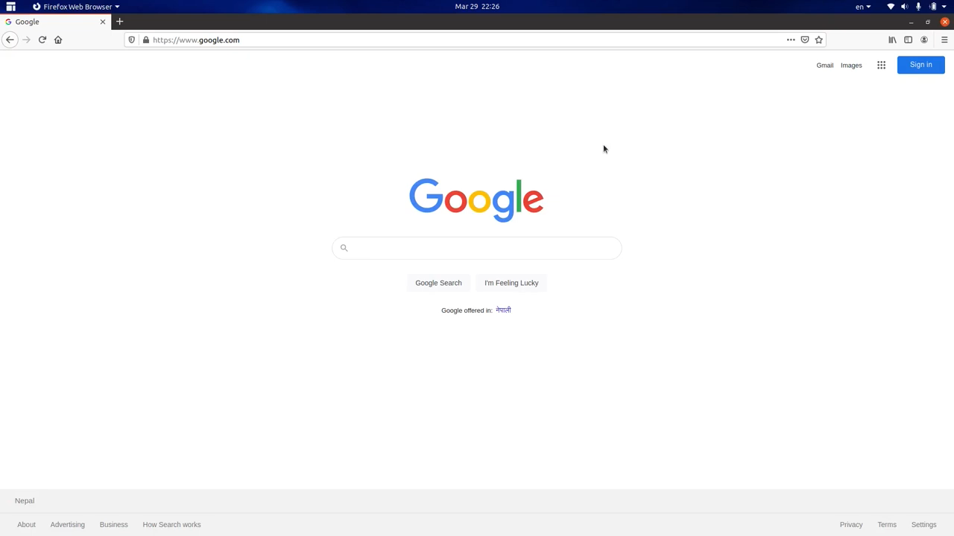

Slide 8
Google Earth Engine Code Editor
Google Earth Engine provides several API's to connect to the Earth Engine. Including :
An interactive javascript Code Editor
A standalone cloud based code editor based on javascript with built in Earth Engine objects and methods.
A python library (on colab, locally etc)
Can be run locally thus allowing the use of the full Python Libaries, however as of now lacks some level of functionality availabla in the JavaScript version.
REST API
Each of these has its own advantages and advantages. Here we will focus on using the interactive Javascript code editor.
Earlier we already did the sign up and registration. So Navigate to the code editor : code.earthengine.google.com. Google recomends the use of Google Chrome to use the code editor.
(Note : The browser actually matters as we are using Javascript most of the common processes actually occurs within the browser locally, i.e on the client side, as you will find out later).
The code editor provides an interactive environment to deal with Earth Engine Applications. Lets explore the code editor environment. Once you initially login image like below will be seen :

Slide 9
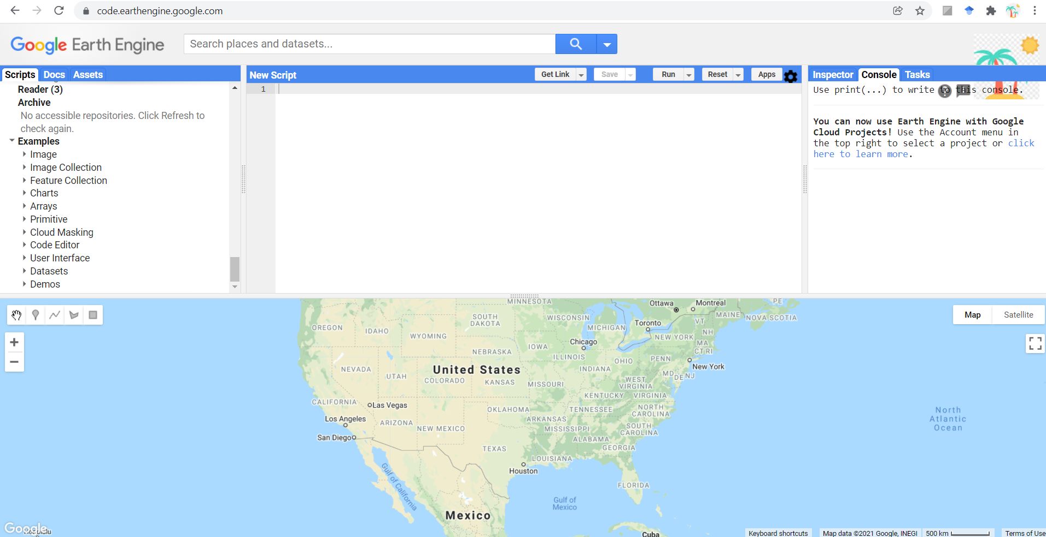

Slide 10
The code editor environment contains the following major components :
The center panel is the JavaScript code editor. All code editing will be carried out here.
Above the editor we have some buttons to SAVE the code, RUN the script as well as to RESET and clear the map. The Get Link button will create a URL in the address bar.
On top of the editor is the search bar, which can be used to search for both datasets and places.
The map at the bottom which pans the entire screen is the map viewer, here the output from the code editor can be added as layers in GIS fashion. The map also contains buttons to switch from MAP to Satellite view, view in Full Screen as well as buttons to Maneuver the map, and add features such as Markers/ Points, Lines, as well as Shapes including Polygons and Rectangles.
The left panel contains the Scripts and the Assets that individual users have uploaded and saved. Further it also contains an a searchable reference box to go through the documentation.
The right panel contains the console tab where generally the output of the scripts such as charts, texts and objects are printed to.
More thorough information on the Earth Engine Code Editor can be obtained from the official Code Editor Documentation.

Slide 11
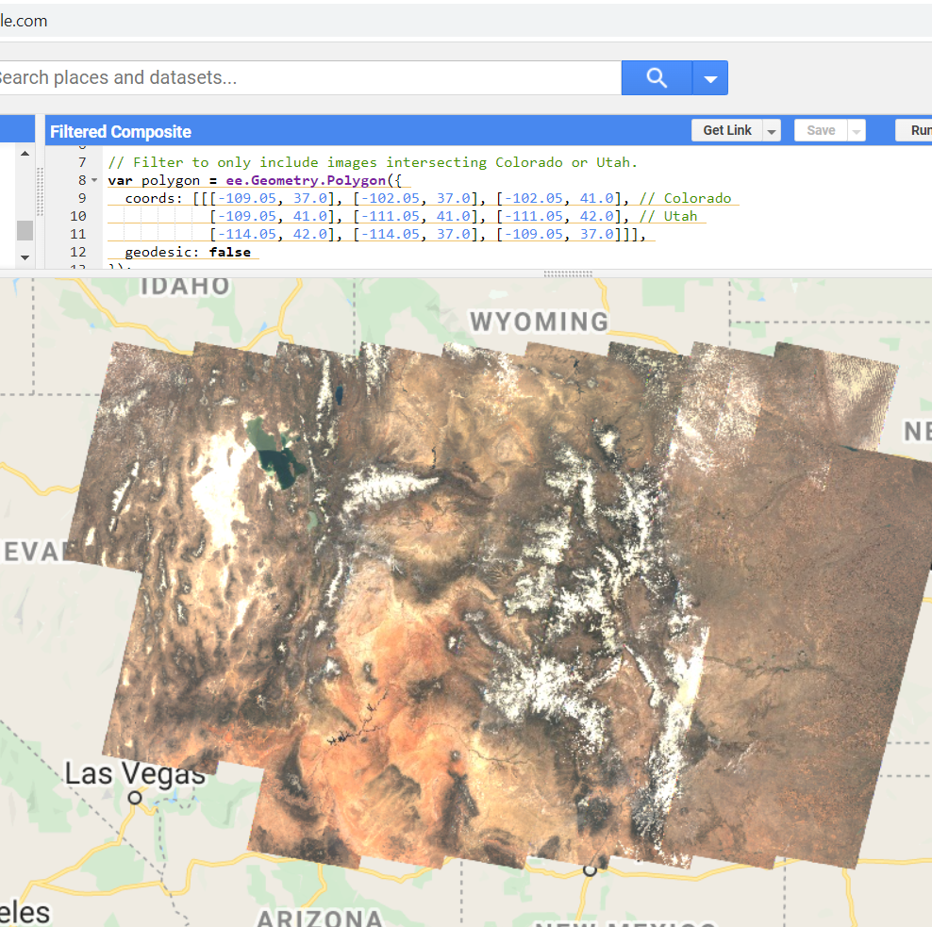
Display and visualise data
So lets go ahead and view something useful.
From the left panel Navigate to Scripts > Examples > Image Collection and select Filtered Composite.
Now click Run and you should be able to see an image like :

Slide 12
So before we begin to getinto JavaScript lets just inspect the code to have a feel of the code.
The first code block, defines a polygon with the geospatial extend of our region of interest (roi), in this case the US states of Colorado and Utah. This type of Geometrical obect in GEE is described as a "Feature". A GEE feature will have a Geometry as well as a dictionary of properties as seen in the code block.
var polygon = ee.Geometry.Polygon({
coords: [[[-109.05, 37.0], [-102.05, 37.0], [-102.05, 41.0], // Colorado
[-109.05, 41.0], [-111.05, 41.0], [-111.05, 42.0], // Utah
[-114.05, 42.0], [-114.05, 37.0], [-109.05, 37.0]]],
geodesic: false
});

Slide 13
Writing the spatial coordinates manually is one way to define a feature in GEE, but we could alterntively, place a Marker, draw a Polygon or a Rectangle as a Shape, or simply upload an external Shapefile as an asset. A collection of Features is defined as a FeatureCollection in GEE.
(Note : It is almost always a good practice to define a roi, as this would save time in processing the data).
The next piece of code creates a time series of images from Landsat7 as a GoogleEarth Engine ImageCollection within a specified time frame and geospatial domain.
var collection = ee.ImageCollection('LANDSAT/LE07/C02/T1_L2')
.filterDate('2000-04-01', '2000-07-01')
.filterBounds(polygon);

Slide 14
Next we calculate median of each band in each pixel across the ImageCollection. This shows the versatility of Earth Engine, by using the ImageCollection Google Earth Engine does all of this calculation as a Server Side calculation. If we were to do it locally this would take a lot of time to download and process the data.
We will have a look at Server Side vs Client Side later.
var median = collection.median();
Next we simply display the results of the code on over map as a layer and set the center of the map on the result.
var result = median.select('SR_B3', 'SR_B2', 'SR_B1');
Map.addLayer(result);
Map.setCenter(-110, 40, 5);

Slide 15
JavaScript for GEE
Before we move on to specific GEE methods and Objects lets have a look at JavaScript first, as we will primarily be using the Earth Engine Code Editor which uses the JavaScript API as we just saw.
For an Introduction JavaScript or JS is commonly described as the language of the Web, with neary all current websites running Javascript. It is supported by all major web browsers which has dedicated JS engines to execute JS scripts on the client/user browser. Generally JavaScript is easy to learn and grasp and has tons of external libraries.
Also important to mention that it does not have much in common with Java.
So lets go ahead and first lets run Hello World. Simply enter (or paste) the code in the Earth Engine code editor and click run to see the output printed to the console tab. Python users will see much familiarity but there are some unique differences.
print('Hello World!');
Observe that a semicolon in JavaScrip denotes the end of a statement. Two forward slashes // denotes comments and placing it before a stetement will comment out the code.

Slide 16
JavaScript Data types
Strings Strings can be defined by using either single quotes ' or double quotes ". However, the GEE style guide specifically mentions that it is preferable to use single quotes while using GEE. Further, paranthess can be used to pass arguments to functions.
var obligatoryhello = 'Hello World!';
print (obligatoryhello)
Numbers
The GEE style guide also recommends using variables to store variouse objects including strings as above, and also numbers :
var sen2_no_of_bands = 13;
print ('Number of bands that Sentinel 2 sattelite images have is :', sen2_no_of_bands)

Slide 17
Lists
A list in JavaScript is defined with square brackets [ ] :
var sen2_bands = ['B1','B2','B3','B4','B5','B6','B7', 'B8', 'B8a', 'B9', 'B10', 'B11', 'B12'];
print ('The 13 bands of Sentinel 2 are :', sen2_bands)
Note that the console is interactive and the list is shown collapsed in the console tab.
Objects
The objects in JavaScript with its key: value pairs are essentially dictionaries.
var Sen2_summary = {
Sattelite: 'Sentinel 2',
Number_of_Bands: 13,
BandNames: ['B1','B2','B3','B4','B5','B6','B7', 'B8', 'B8a', 'B9', 'B10', 'B11', 'B12']
};
print('Dictionary:', Sen2_summary);

Slide 18
Items within the dictionary can be accessed by using square brackets, for example :
print('Name of Sattelite:', Sen2_summary['Sattelite']);
or using dot notation :
print('Name of Sattelite:', Sen2_summary.Sattelite);
Here the a new function, which takes in two parameters (param1, param2) is assigned to to the variable testFunction. Any sort of data manipulaton can occur within the function and returned.
Functions
Functions are defined with the keyword function and should start with a letter. The parameters of the function goes inside brackets () and the statements which makes up the function goes inside curly brackets {}. The output of the function is dictated by the keyword return. For example a typical function will look like :
var testFunction = function(param1, param2) {
statement1;
statement2;
statement3;
return statement;
};
Here the a new function, which takes in two parameters (param1, param2) is assigned to to the variable testFunction. Any sort of data manipulaton can occur within the function and returned.

